Slide 1
Adding VEP to AUC models
Adam Shah

Slide 2
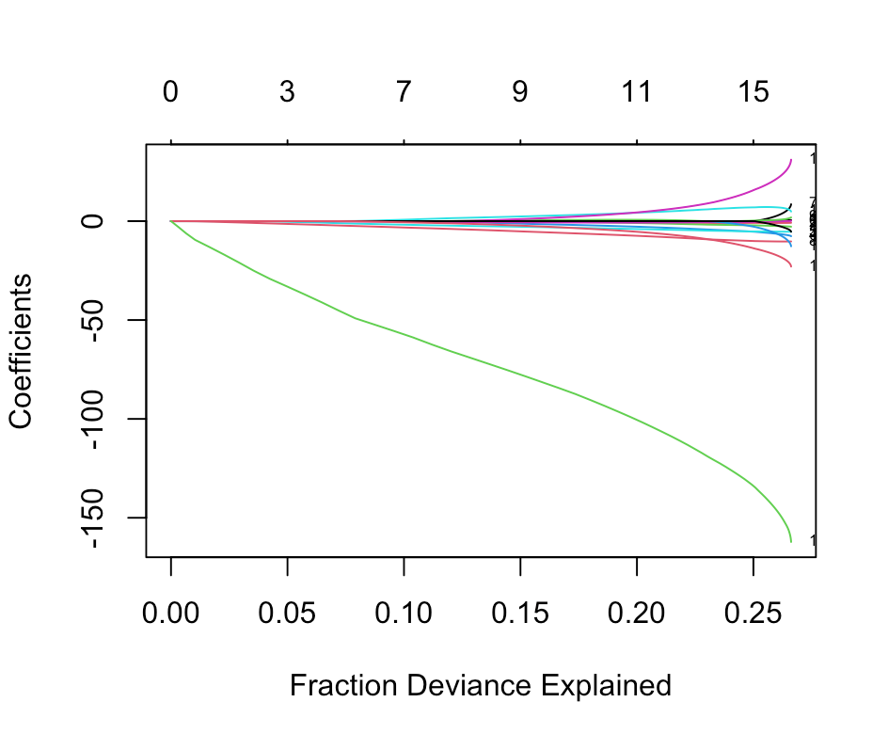
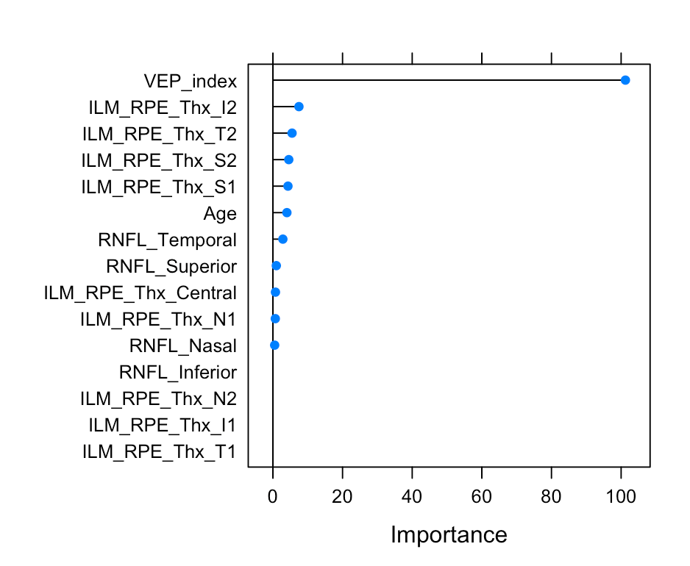
Adding VEP to model (monocular model)

Slide 3
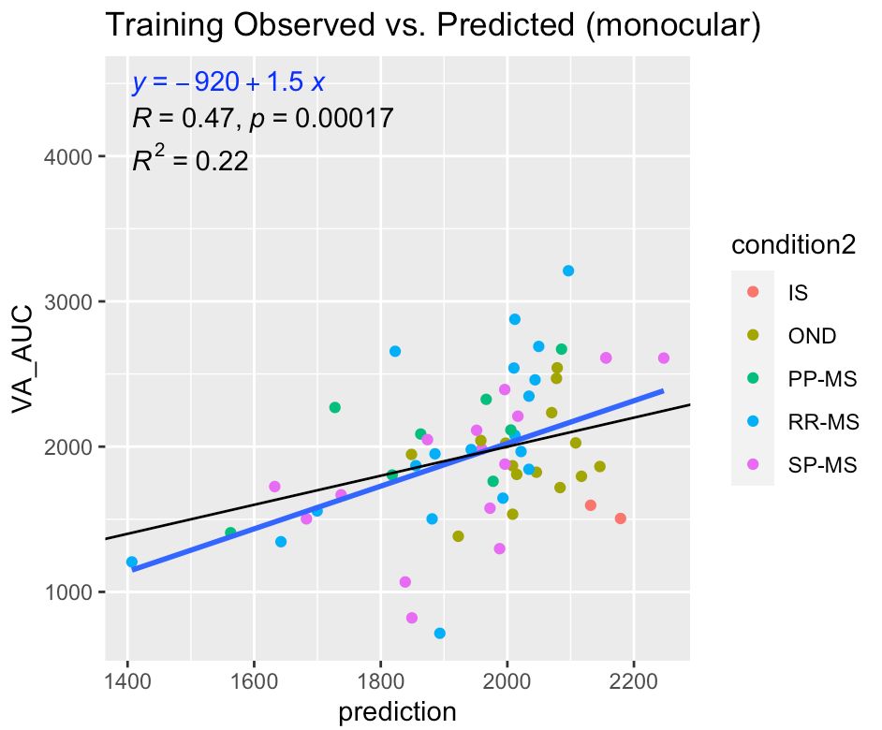
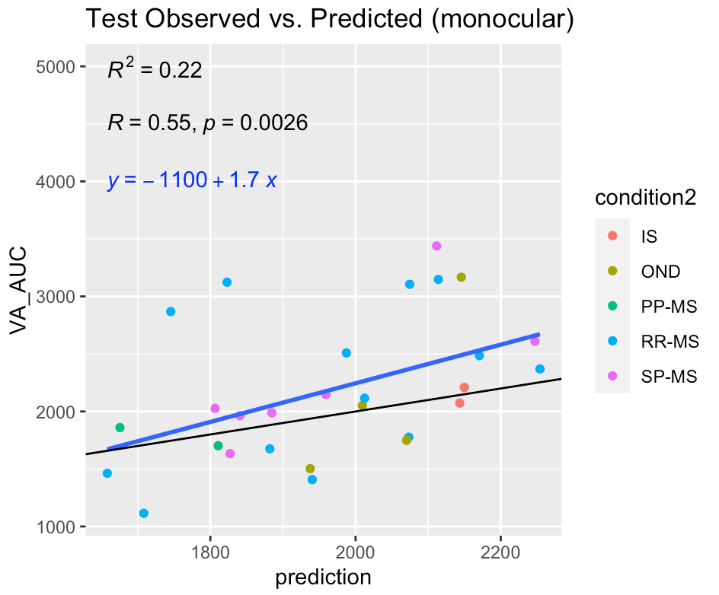
Validity of model with VEP included
*original model had R^2 values of 0.14 and 0.13 respectively

Slide 4
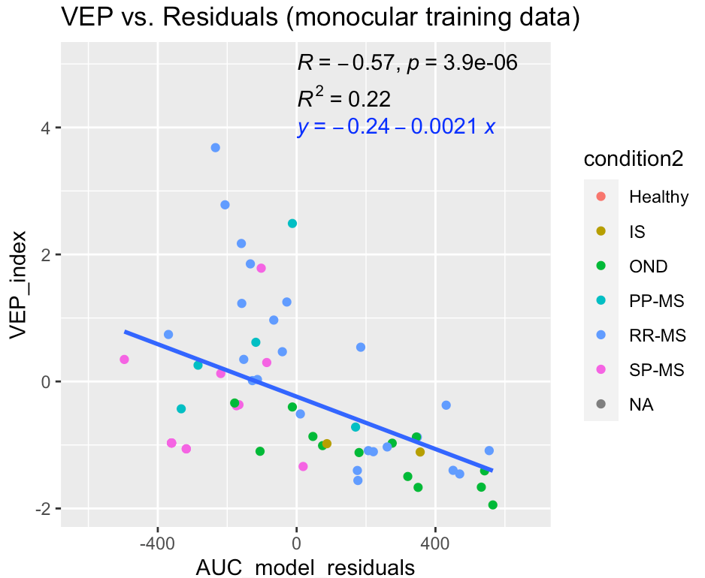
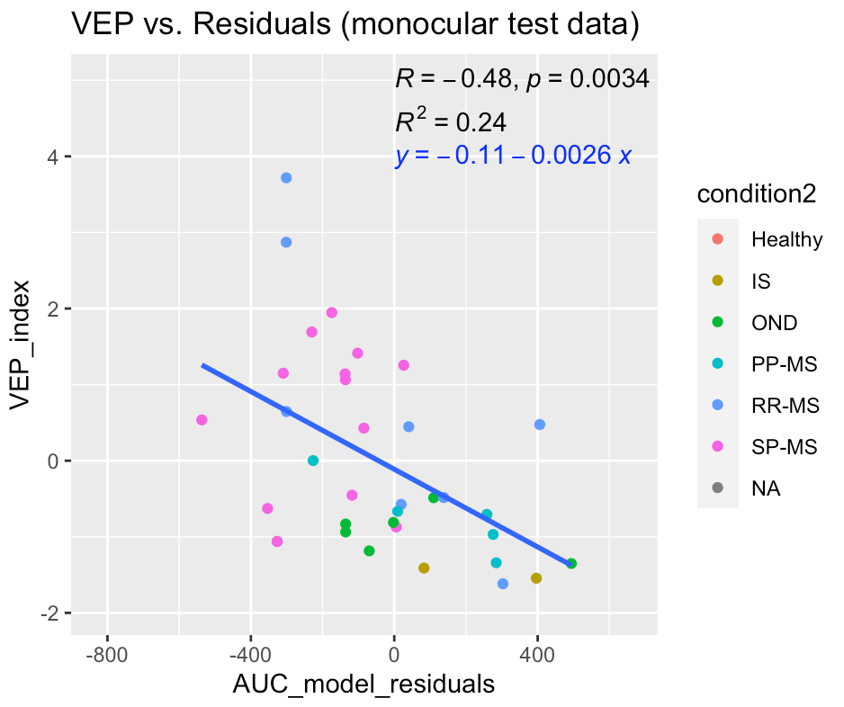
Using VEP to explain residuals in original monocular model (without VEP)

Slide 5
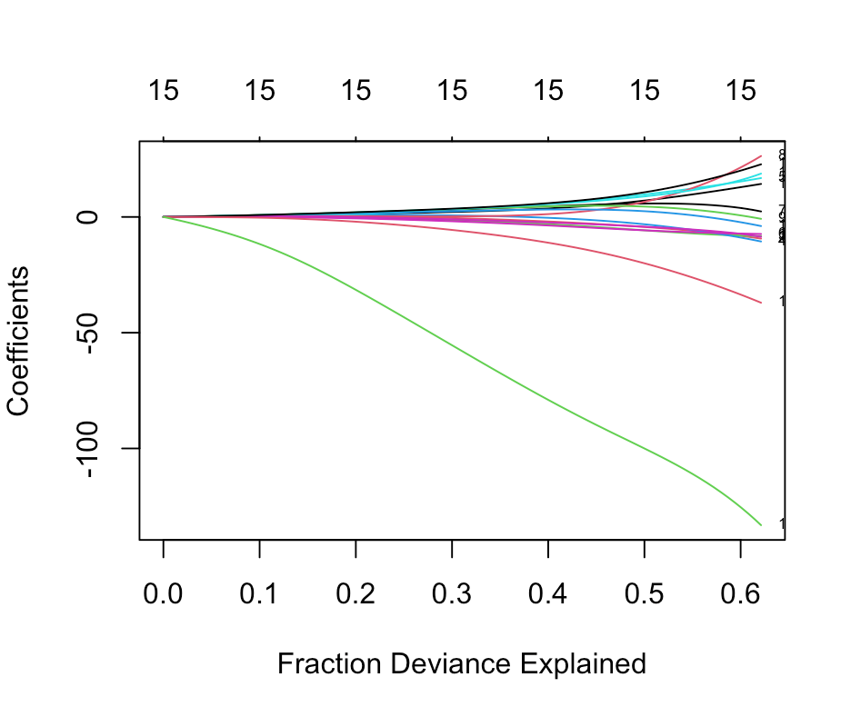
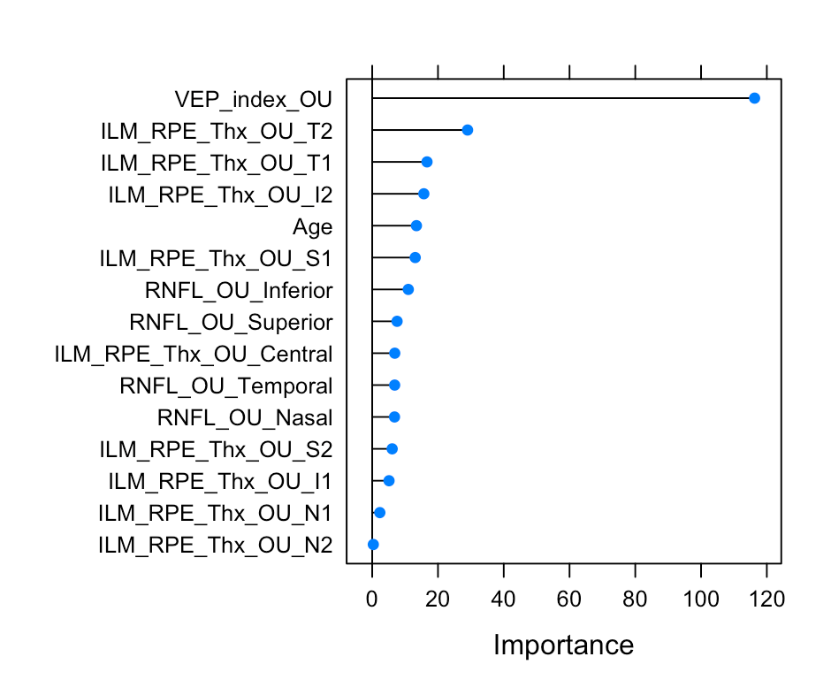
Adding VEP to model (binocular model)

Slide 6
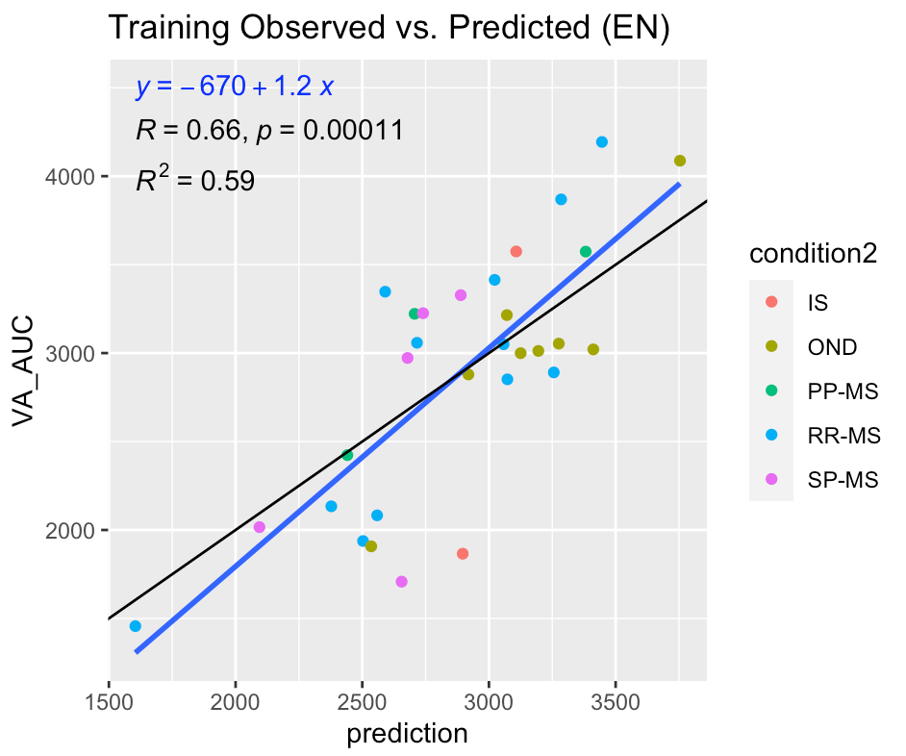
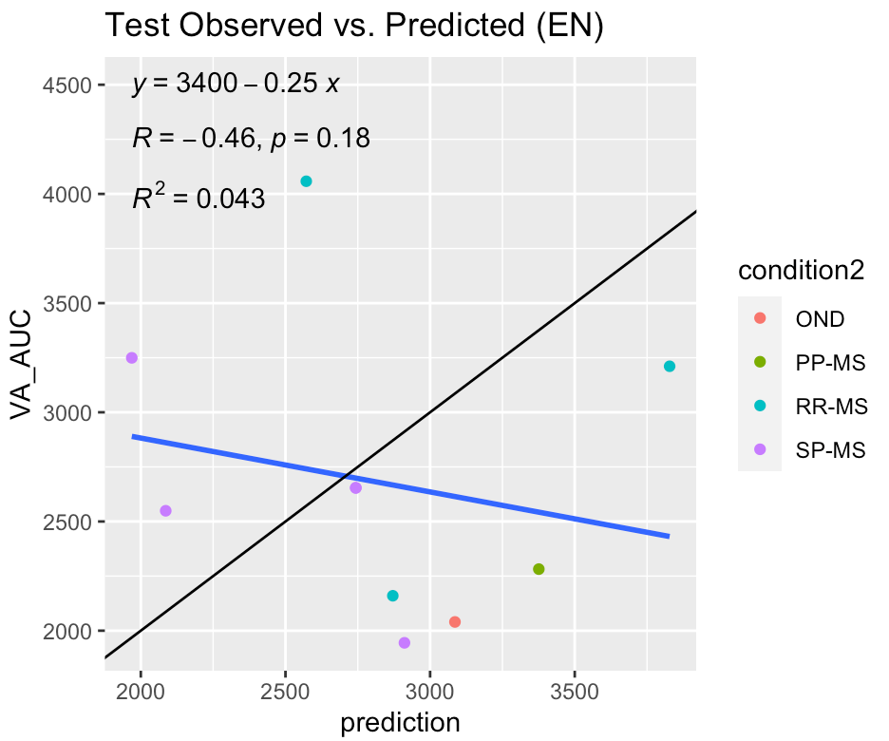
Validity of model with VEP included
*I don’t think there are enough observations in the binocular model that have VEP
to make accurate model

Slide 7
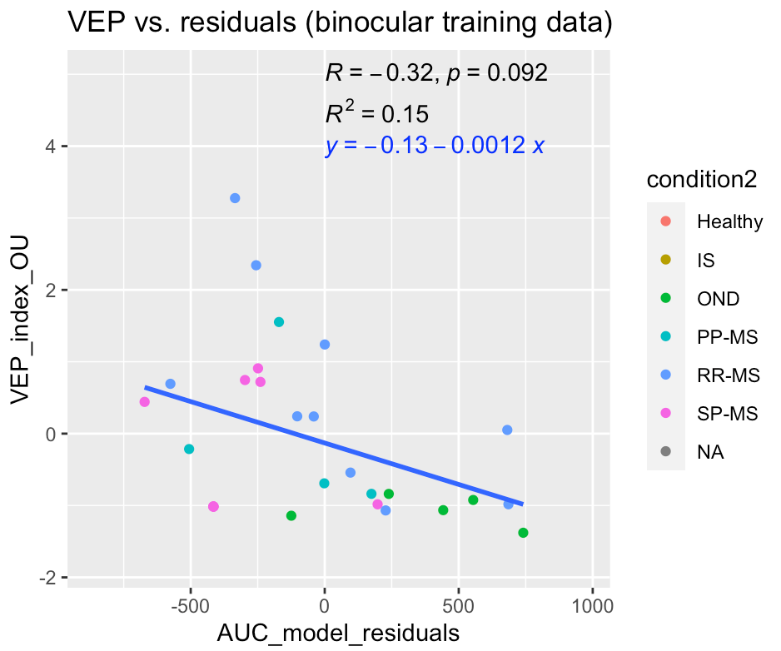
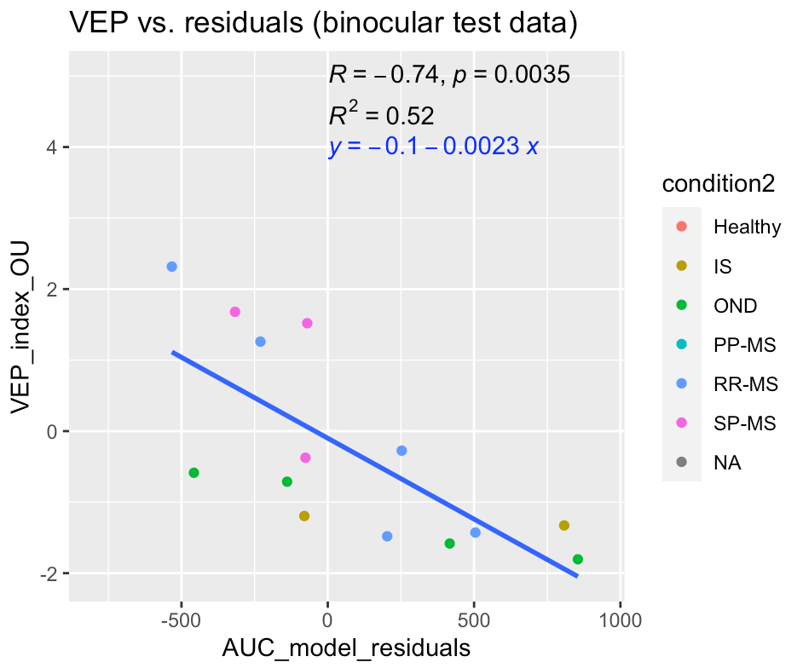
Using VEP to explain residuals in original binocular model

